Slide 1
EDGE DETECTION
Haobo Chen
Ni Kang
Haoming Zhang

Slide 2
Introduction of Project and Team
What is it and what does it do
Why and where would our design be useful
Main goals and constraints of the project

Slide 3
What is it and what does it do
Edge detection is a basic problem for image processing and computer visualization, whose aim is to denote the points which change obviously in digital image. The obvious changes in image properties usually reflect the property’s important events and changes, which includes: discontinuity in depth, discontinuity on surface, the changes in matter properties and the brightness change in a specific scenario. Image edge detection drastically decreases the number of data and eliminates the irrelevant information which keeps the important properties of the image structure.

Slide 4
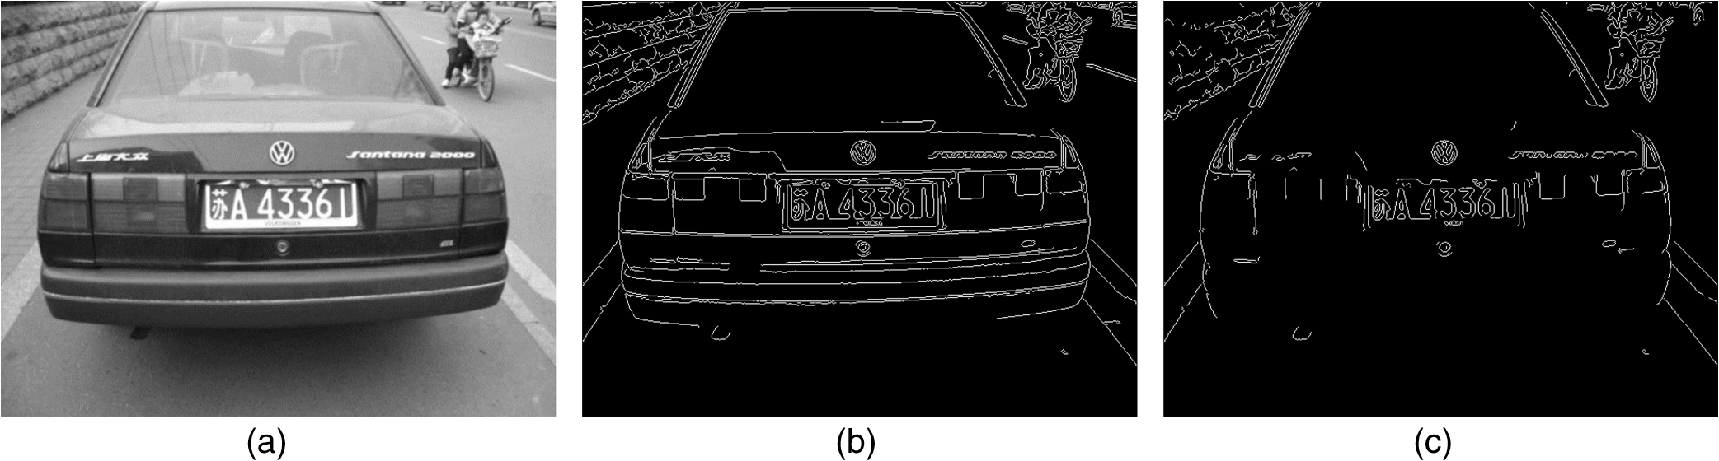

Slide 5
Why and where would our design be useful
Edge detection could be really useful in a lot of aspects in life. As seen in the picture on the last slide, it can be used to detect the car plate number. Detecting the car plate number from a diagram is a useful application in China nowadays since we have surveillance cameras at almost every main road and crossroad. Also, it can be used as face detection. After the edge detection, the detected face can be sent to other algorithms and to be used in a lot of application like the new iPhoneX’s face ID.

Slide 6
Main goals and constraints of the project
Main goal: being able to produce a edge detector for images, and the process time should be approximately 1s.
Constraints: Area (Fabrication process or cost limits)
Delay/Clock Rate (Technology delay or clock generation limits)

Slide 7
System View of Project
System level diagrams
High-level view of used interfaces & standards

Slide 8
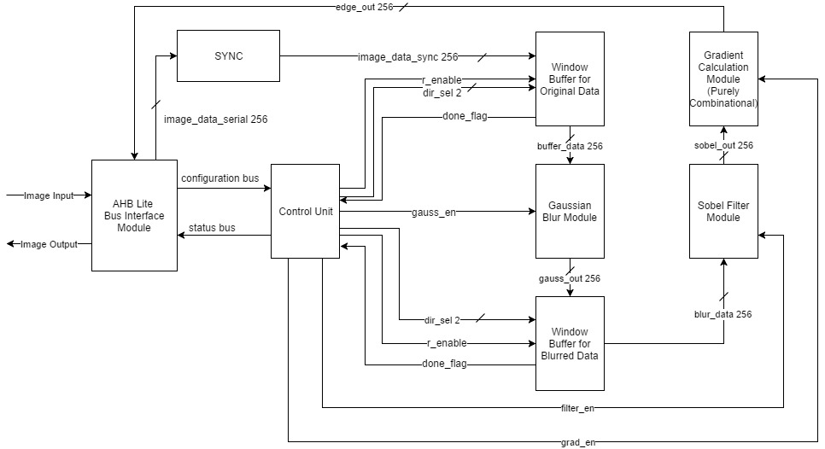
System level diagrams

Slide 9
High-level view of used interfaces & standards
Things acquired from users: the image needed to be filtered and the size of the image
Things out: the image filtered

Slide 10
Hardware Usage
Hardware interface requirements
AHB Lite Standard Slave
a. 256-bit data bus
b. Read and Write Transfers
c. Burst Transfers Supported
d. Pipelined Transfers
e. 3-bit, 8 word-address namespace (0x000 → 0x007)

Slide 11
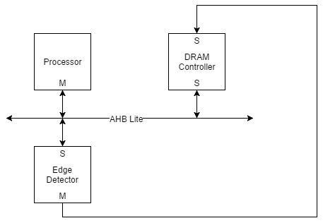
Hardware Usage Diagram

Slide 12
Architecture of the design
Top-Level Diagram
Roles of Top-level blocks
Top-level block interactions
Operational flow at the top-level

Slide 13
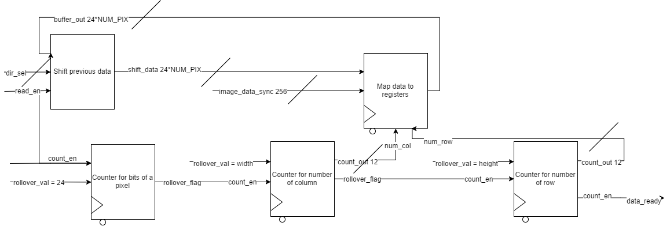
Window Buffer Module

Slide 14
Role of Window Buffer Module
The window buffer will be utilized to store the original and blurred data. But the implementation is identical. First the dir_sel flag will be used to decide the behavior of the shifting operation. If dir_sel is 11, it means that this is the first time the module gets executed. Otherwise, it indicate the direction of shifting operation. If r_enable is asserted, the image data will be read in serially and be stored in the empty parts of the shifted buffer. A combination of new data and old data will form the next buffer_data to be calculated. The done_flag is asserted only when the internal counter reaches it’s rollover flag.

Slide 15
Gaussian Filter Module
The Gaussian Blur module is a pure combinational block that will take in the data(8*8*24 bits) output from window buffer module and execute the value. Add the surrounding 8 pixels and itself, then divided by 9 we will get the average value of the middle pixel and pass a 6*6 pixels to the next window buffer.

Slide 16
Sobel Filter Module
This is a purely combinational block, which will calculate two values for each pixel. The input of this module is a 4*4 pixel array, and the output should be two arrays calculated by the middle 2*2 pixels. One of the output arrays should be the horizontally calculated value of the 4 pixels, and the other one is the vertically calculated value of the 4 pixels. And the diagrams of the specific algorithm are shown as follow:
-1
0
1
-1 | 0 | 1

Slide 17
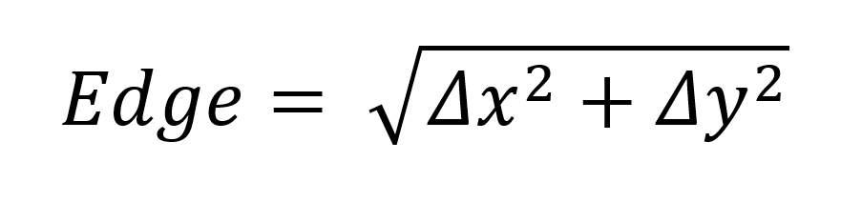

Gradient Calculation Module
After a group of gradients is found, the Pythagorean theorem is applied to the two gradient vectors. Since it is possible to have a negative gradient, it is necessary to take the absolute values of them. And then, we need to calculate a value to compare it with a threshold value which will be determined later during the actual ‘doing’ process. And the value will be calculated by the formula as follow:
Since it’s difficult to deal with the square root, so we change it as follow:

Slide 18
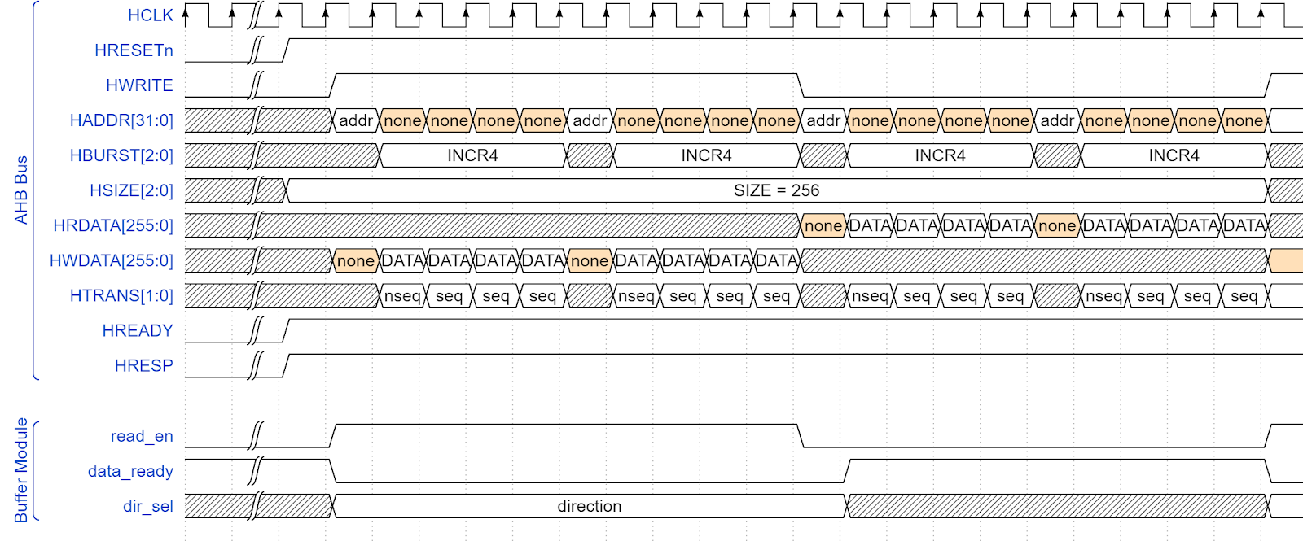
Top level block interactions

Slide 19
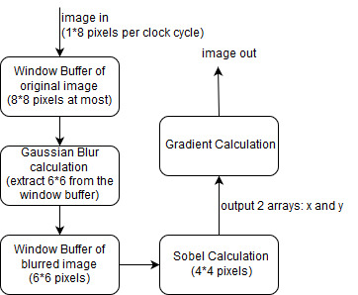
Operational flow at the top-level

Slide 20
Current/projected implementation
At the first beginning, we thought that every one of our calculation block should be sequential since we didn’t want data to be parallel in. But afterwards, we realized that registers take up too much spaces for image processing, so we decided that we would use purely combinational block since that would only use wires to transfer data, which does not take too much spaces. So that the only complicated problem now is the window buffers since we want the logic in the combinational blocks to be as simple as possible. Although there are two window buffers, they are doing the same task, so we just need one algorithm and replace the parameters inside of it.

Slide 21
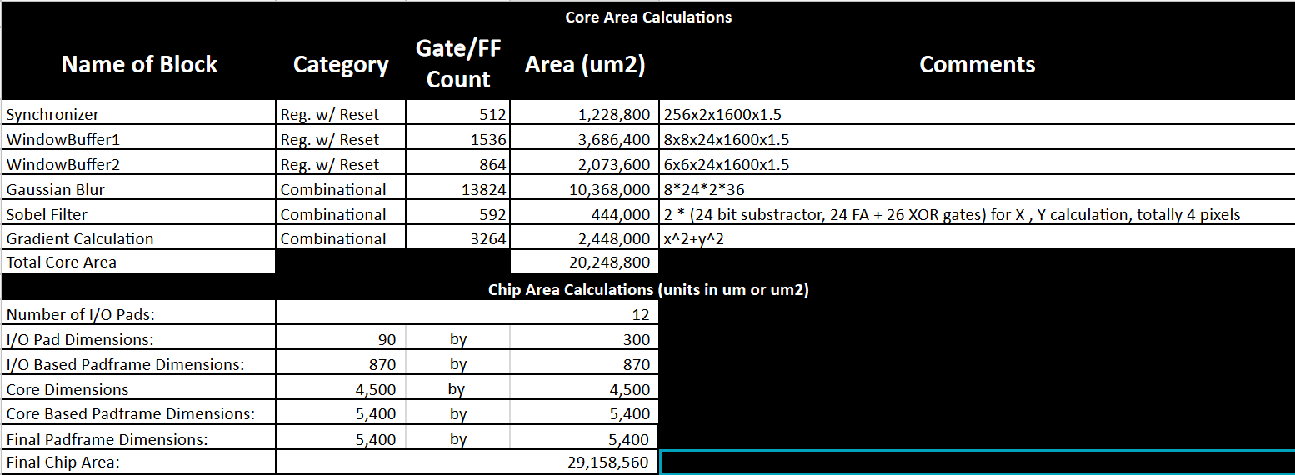
Area Budget Summary

Slide 22
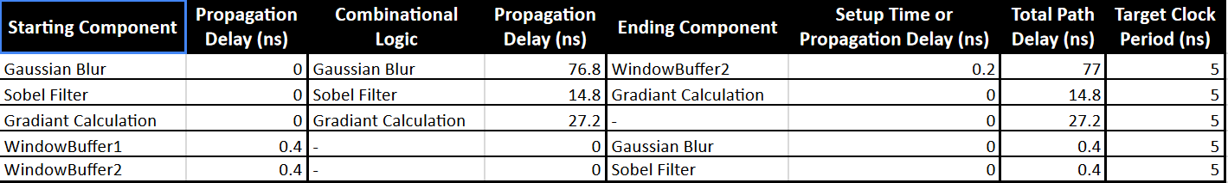
Propagation Delay Summary

Slide 23
Remaining Timeline
Week of Apr 2nd: Write code of window buffer and testbench
Week of Apr 9th: Write code of gaussian blur and testbench
Week of Apr 16th: Write code of Sobel and Gradient and testbench
Week of Apr 23rd: Write the final report and prepare the presentation

Slide 24
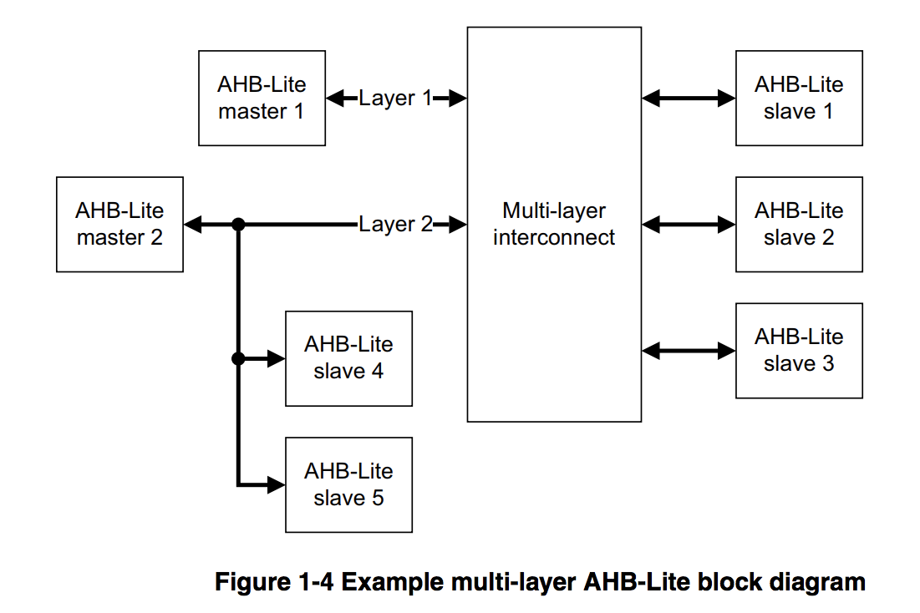
Excerpt

